Slide 1


NILE TECHNOLOGIES
Developing a Compelling Model

Slide 2

In Brief…
Professionally
Managed
Certified Consultants, Project Managers
2000+ person years of experience
Experienced Senior Management
Young & Agile
14 + Years in Operation
India Based
Strong Financial backing
Fast Growing
200 + Projects
40 + Clients
5 Countries
100 + Team
01 offices
Innovation Driven
Investing on Technology, People & Industry

Slide 3
Our Growth Journey…
ESTABLISHMENT
GROWTH
ACHIEVEMENT
Established in September 2011 by Senior Professionals from Oracle, Accenture and IBM
Started in 2011-12 with 10 Employees & grew to 40 Employees by 2014-15
Today we are 100 + Employees
Young and Agile with experienced professionals , state-of-the-art technology and a proven track record
Completed over 200 + Customer Implementations
100% Success Rate in Implementations with Customer References
Over 100 + Satisfied Customers

Slide 4
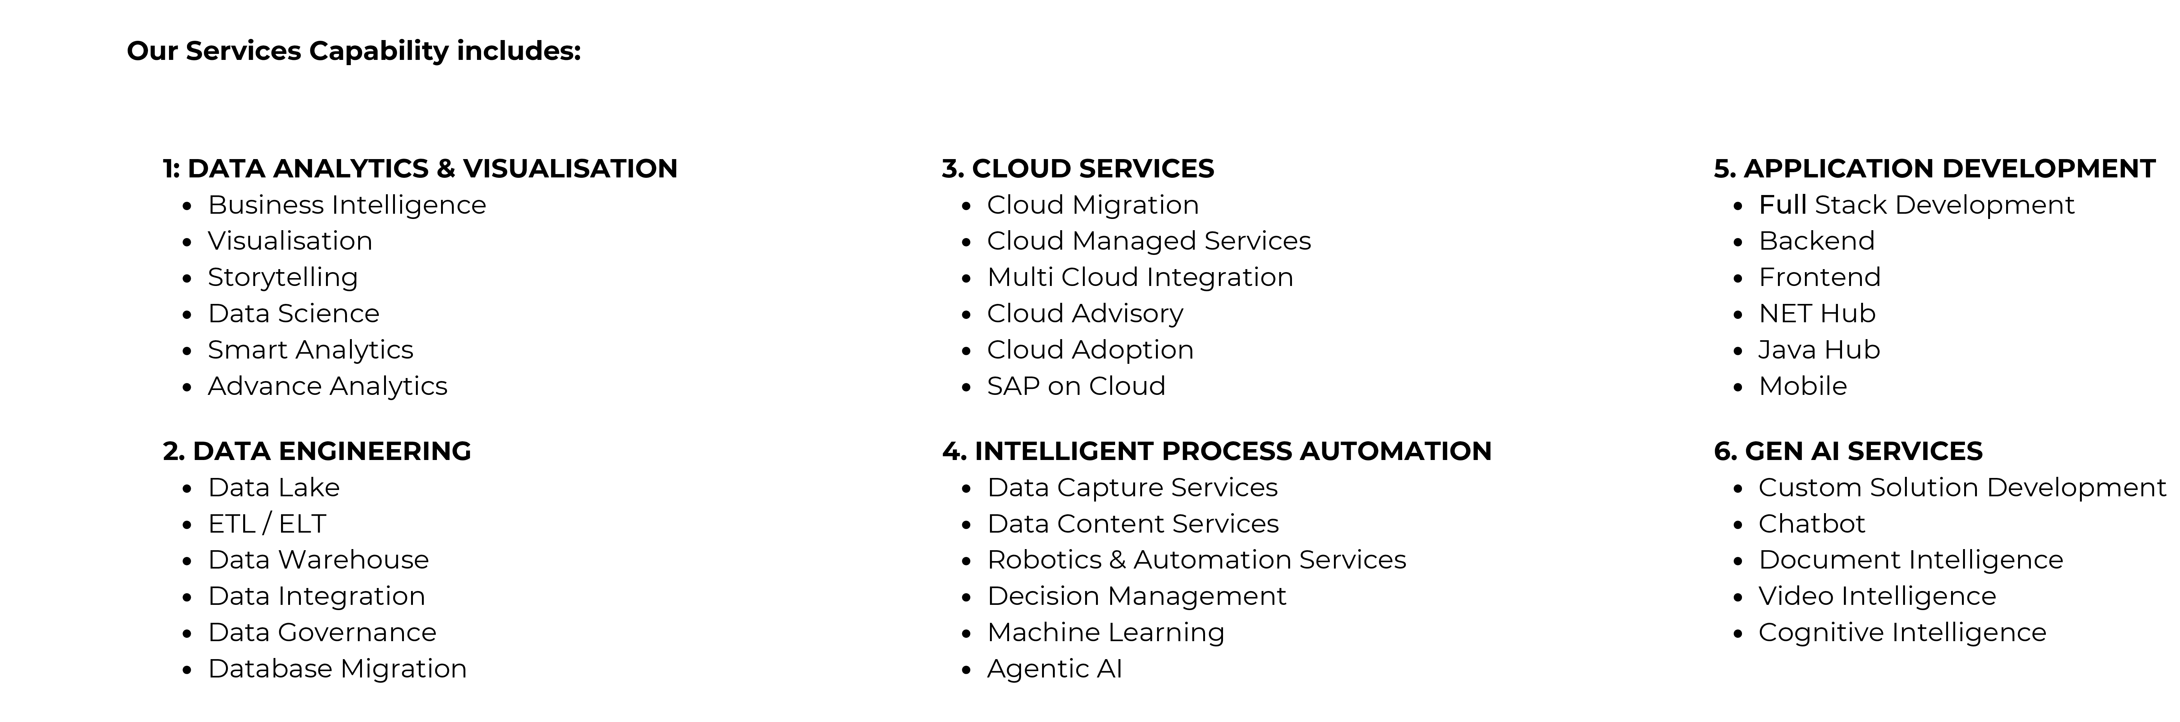
Core Capabilities

Slide 5
AI Capabilities…
GEN AI
  Text generation, translation, and summarization
  Image and video synthesis
  Content creation
  Natural language processing
AGENTIC
  Autonomous problem-solving
  Task completion
  Decision making
  Personalization
No. of Resources: 40+
Developing Use-cases for large multi-national clients
Open to working with clients on problem solving and use cases

Slide 6
Why Nile…..
Expertise & Specialization : Our team comprises experts in AI, ML, Analytics & Managed Services.
Global Reach : Nile has a strong track record of working with global clients in diverse industries. Our experience enables us to understand unique challenges and opportunities faced by enterprise organizations.
Custom Solutions: Every project is delivered based on its unique requirements. Customizations ensure that our clients received maximum value from our services
Omnichannel Digital Platform: Our use of Omnichannel digital platform enables seamless integration across various channels creating a unified enhanced experience
Vision and Mission: Our vision is to be “Desired Company” in our areas of operations. We aim to fully deliver our projects with least nuances.

Slide 7
Nile’s Application Development Projects…
User Interfaces: Develop web browser user interfaces using HTML5, CSS and JavaScript frameworks like ReactJS, Angular JS and plain Javascript
API Integration: Integrate the application with existing API’s to enable Data exchange and functionality
Middleware Development: Create or modify middleware for Nod.js-based API’s as necessary to facilitate communication and processing
API Development: Develop API’s using AWS Solutions including AWS Laambda functions and API Gateway for scalable and efficient data access
Data Integration: Connect the application with backend data sources such as S3, MySQL , Databricks, Athena and Redshift for data retrieval and storage
Data Visualization: Design Visualizations using tools like HighCharts and D3 to present data effectively
Testing and Document : Conduct Unit tests to ensure the quality of developed software and provide comprehensive documentation for reference
End-to-End Testing: Perform end-to-end testing to validate the functionality and performance of the developed software across entire application
In summary, the application development project involves creating user interface, integration with various API’s and data sources, developing middleware and API’s, designing visualizations, testing and documentation.

Slide 8






Development Services…Partners
Airtel Partner Registration & Invoice Digitization Portal
IFFCO SSC Sharjah AP Automation Portal
Magma Leasing Portal Implementation
Reliance Jio Portal Implementation
Telenor 40 TB Data Migration
Aircel Consumer Portal Optimization & Upgrade
Genpact Primavera Portal
HPSEBL Fusion Middleware Implementation
GE SBI Fusion Middleware Implementation
Nucor Steel US Fusion Middleware Implementation & Service Orchestration
GE Oil & Gas Singapore Fusion Middleware Implementation & Service Orchestration

Slide 9






Development Services…Clients
Refund Management Process Implementation (BPM & Portal)
Customs BOE Module Implementation on Portal
Partner Screening Process
On-Going Enhancements
Global Invoice Dispatch System (GDS) Implementation
Oracle ICS Implementation
Oracle ICS to OIC Migration
SSC AP Automation Oracle ODI Implementation
SSC AP Automation Portal On-Going Enhancements
Implementation of BPM for billing of VAS
10 TB Consumer Data Migration from Legacy System to Newgen OmniDocs Content Management

Slide 10
Maharashtra Govt.-CM Dashboard …thru a partner front-end company
Empowering Maharashtra Government Digital Transformation through Datalake Solution for CM Dashboard
Using Unified Data Analysis Solution, business intelligence, data architecture, and cloud-native reporting to design and deliver an integrated analytics ecosystem using Microsoft Fabric. This solution empowers departments to make timely, data-backed decisions through real-time dashboards and structured insights across various Chief Minister-led schemes.
Successfully developed and deployed over 1000+ advanced dashboards covering a wide array of Maharashtra’s key welfare and development schemes

Slide 11
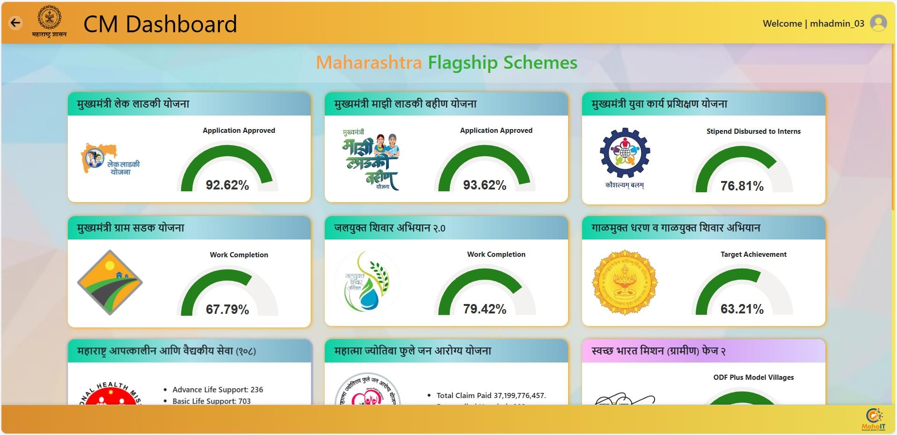

Slide 12
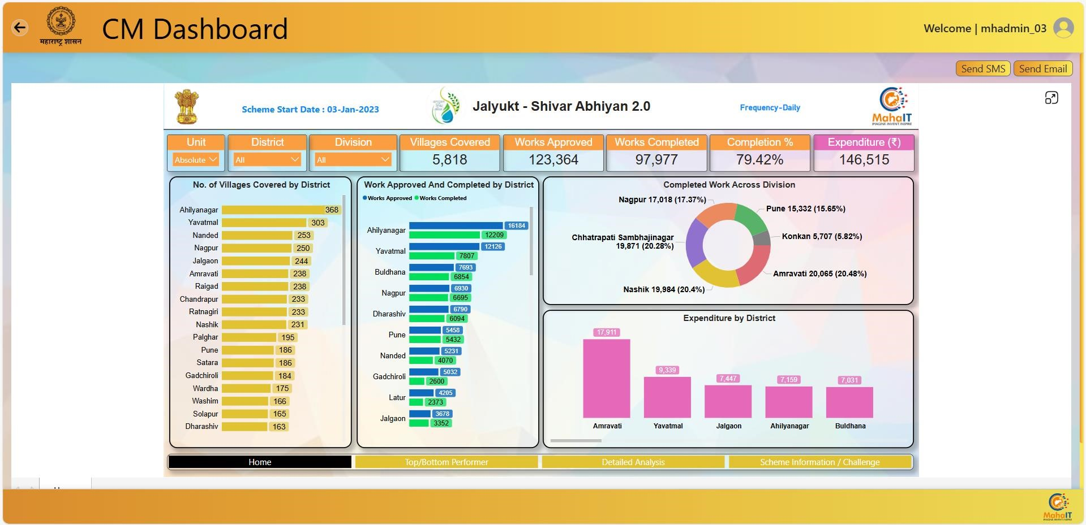

Slide 13
Airtel Partner Portal & Invoice Digitization Project
Key Functional Modules:
Supplier Onboarding & Site Creation
  Domestic & Foreign partner registration with approval workflows
  Integrated with DMS, NSDL, GSTN, Penny Testing & Oracle EBS
  Automated ERP updates for supplier/site data
2. Supplier Maintenance
  Portal-based change requests (Org, Bank, Contacts)
  Approval dashboards for Master & CA teams
  Real-time ERP sync for updates
3. Invoice Processing
  Dashboards for invoice creation, tracking & approval
  Workflow routing via DOA
  ASN generation & ERP posting upon approval
4. Bill of Entry (BoE)
  Shipping info submission, checklist validation, invoice sync
  Multi-role dashboards (Partner, CHA, SCM, IP)
  Integrations: Oracle EBS, Airtel SSO, DMS, NSDL, GSTN, eMudhra, Logisys, ServiceNow, Email/SMS Gateways

Slide 14

Himachal Pradesh State Electricity Board Project
Objective:
Integrate legacy applications using Oracle SOA Suite and deliver a unified user experience across enterprise systems.
SOA Integration Layer
BPEL orchestrations for CRM, MDM, and EA systems.
Unified Interface
Single WebLogic Portal UI for all legacy applications with SSO via CA SiteMinder.
Document Management
Integration with Oracle UCM for secure storage, workflows, and role-based access.
Deployment Architecture
Enterprise-level setup using Oracle SOA Suite, WebLogic Portal, and UCM.

Slide 15
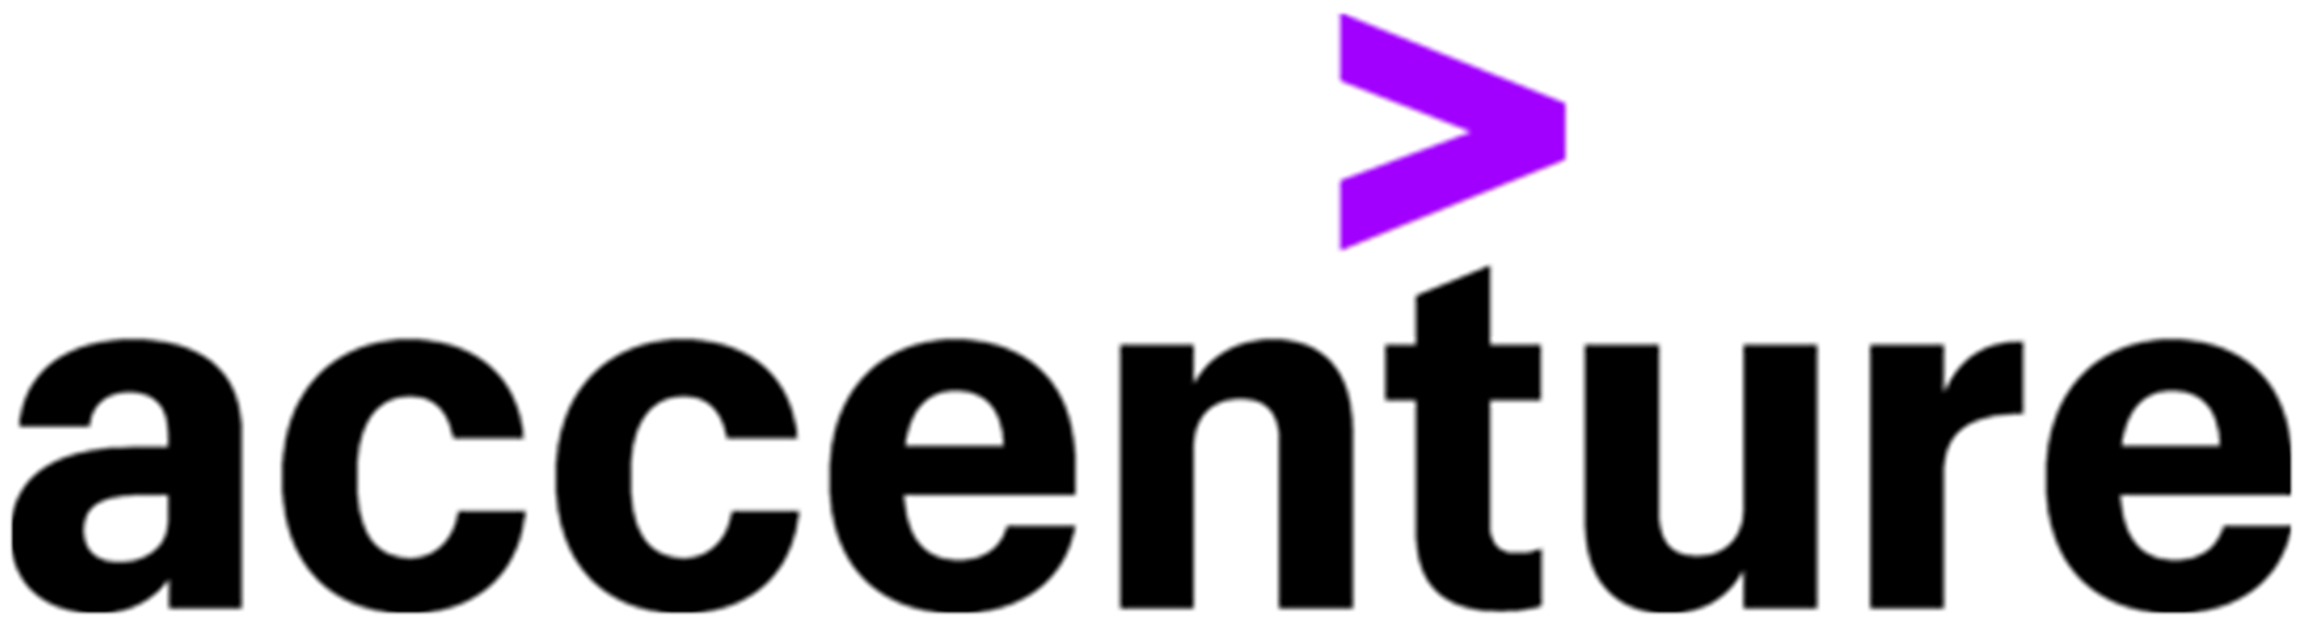
Managed Services…
Airtel Partner Registration & Invoice Digitization Portal Support
Airtel Partner Registration & Invoice Digitization Portal Support
IFFCO SSC Sharjah AP Automation Portal Support
HPSEBL Integration Services and OWCC Support

Slide 16
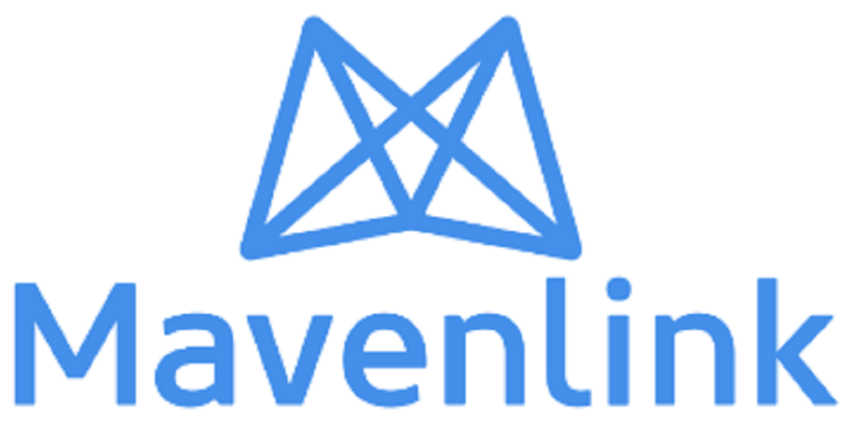
Managed Services…
Global Invoice Dispatch System (GDS) Support
Primavera Portal Support
OIC Integration Service Support
SSC Sharjah AP Automation Portal Support
Genpact Mavenlink Integration Support for Resourcing & Skill Management

Slide 17
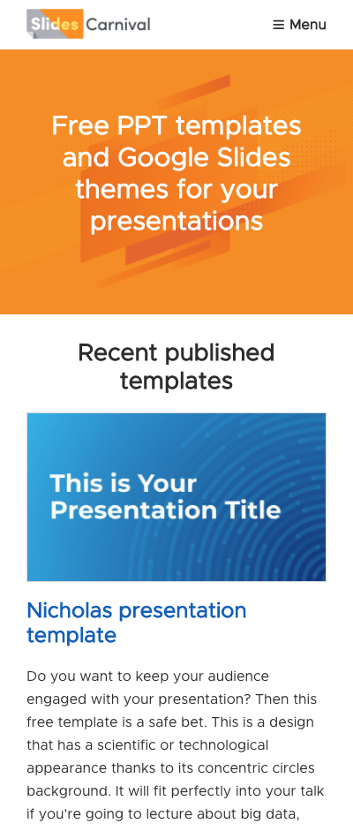
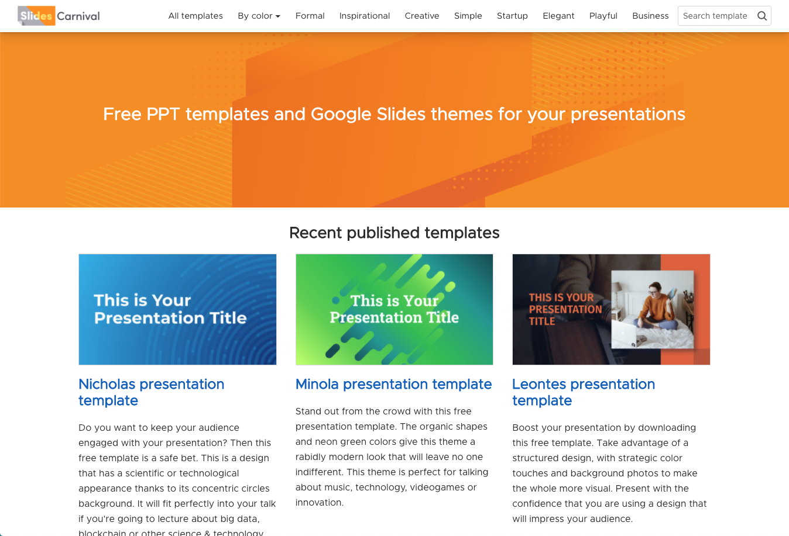
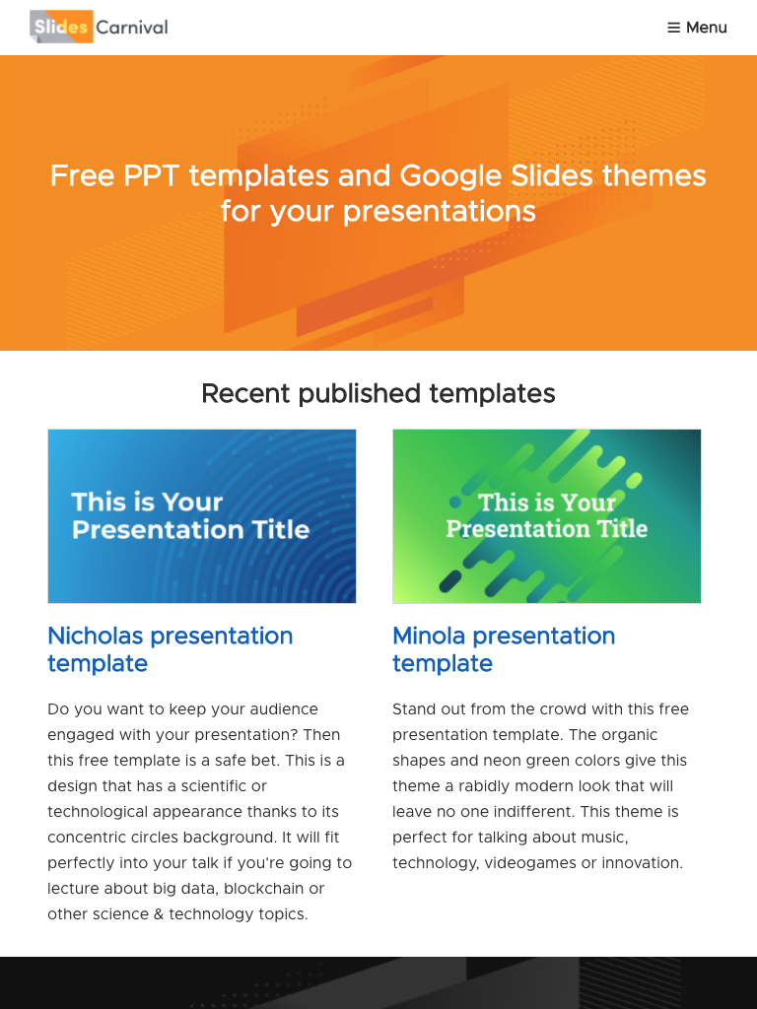
Open Source
Our Opensource function works with a team of designers and content managers to produce industry leading Mobile & Web Apps. Our experience of integration helps our customers in bi-directional integration of data from the Mobile App to the Web App or vice versa.
We have a dedicated team of more than 30+ certified developers for iOS, Android, PHP, React Native, React.JS, Node.JS, Mongo DB, Postgres SQL etc. with proven experience in creating and modernizing Mobile & Web apps and solutions.

Slide 18






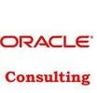









Enterprise Customer Snapshot

Slide 19
Thank You

